Slide 1
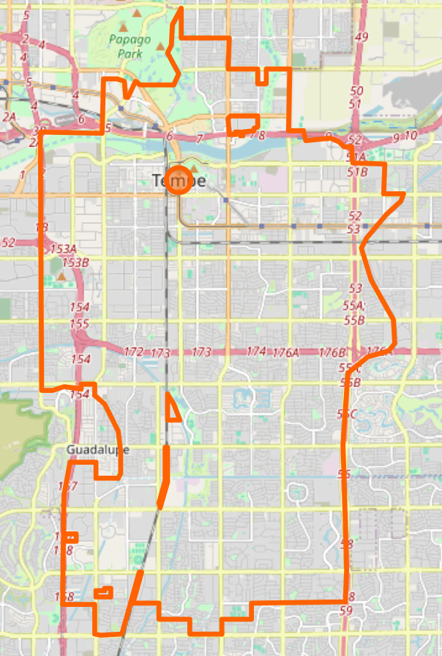
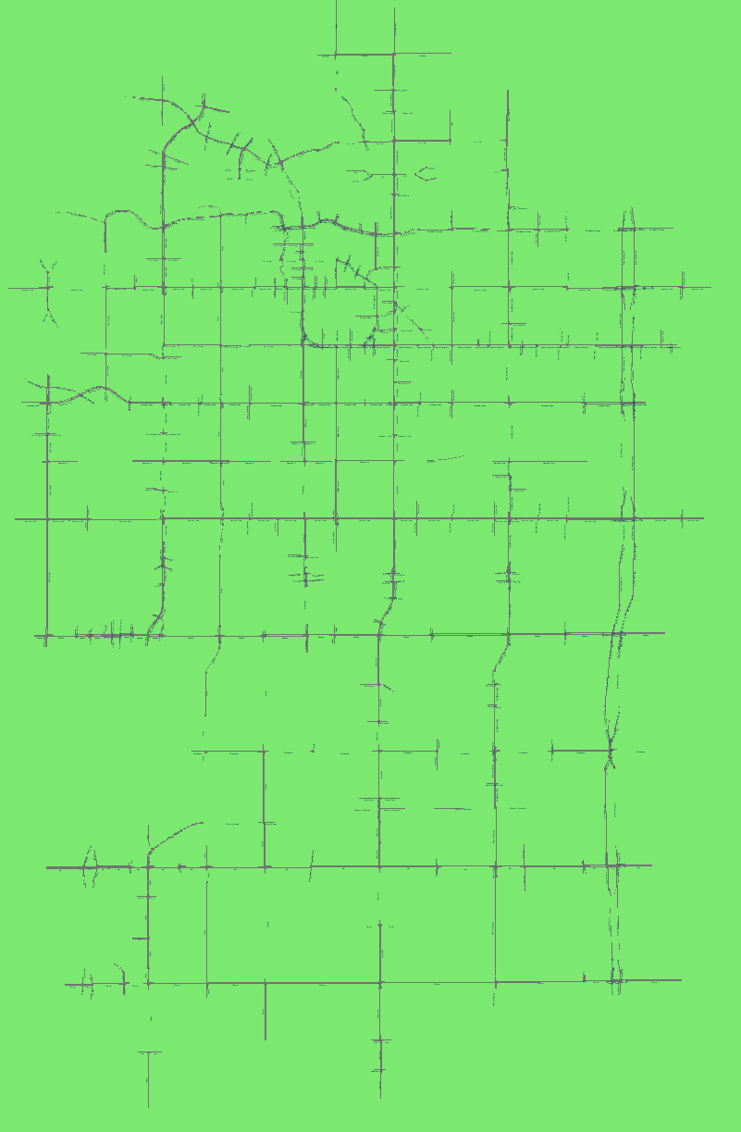
OSM & Synchro Network

Slide 2
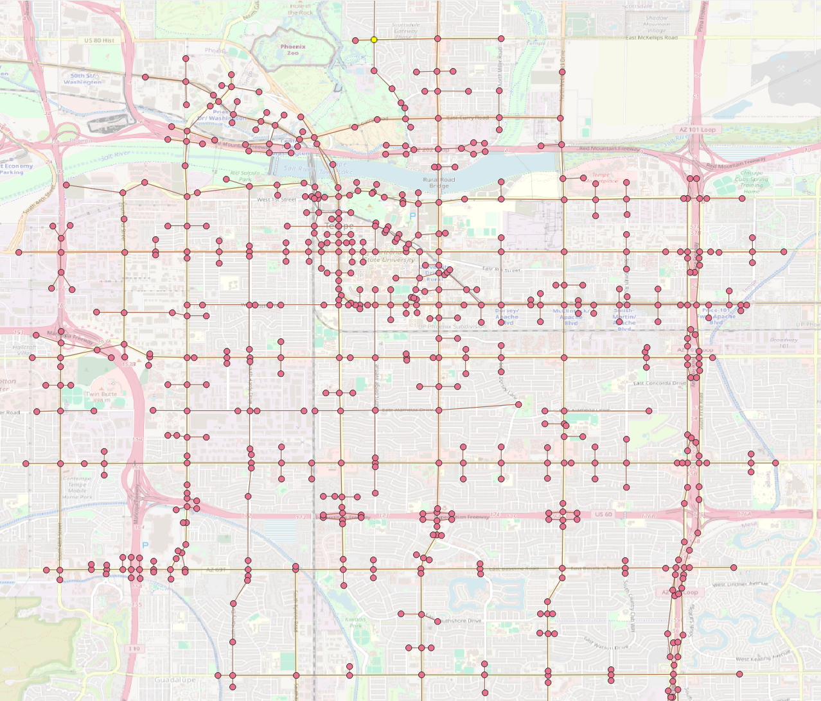
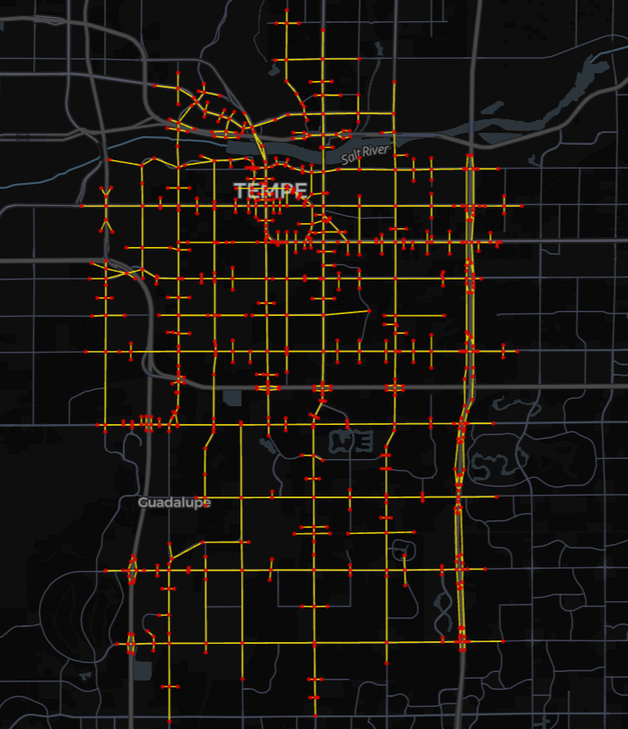
GMNS Standard Network

Slide 3
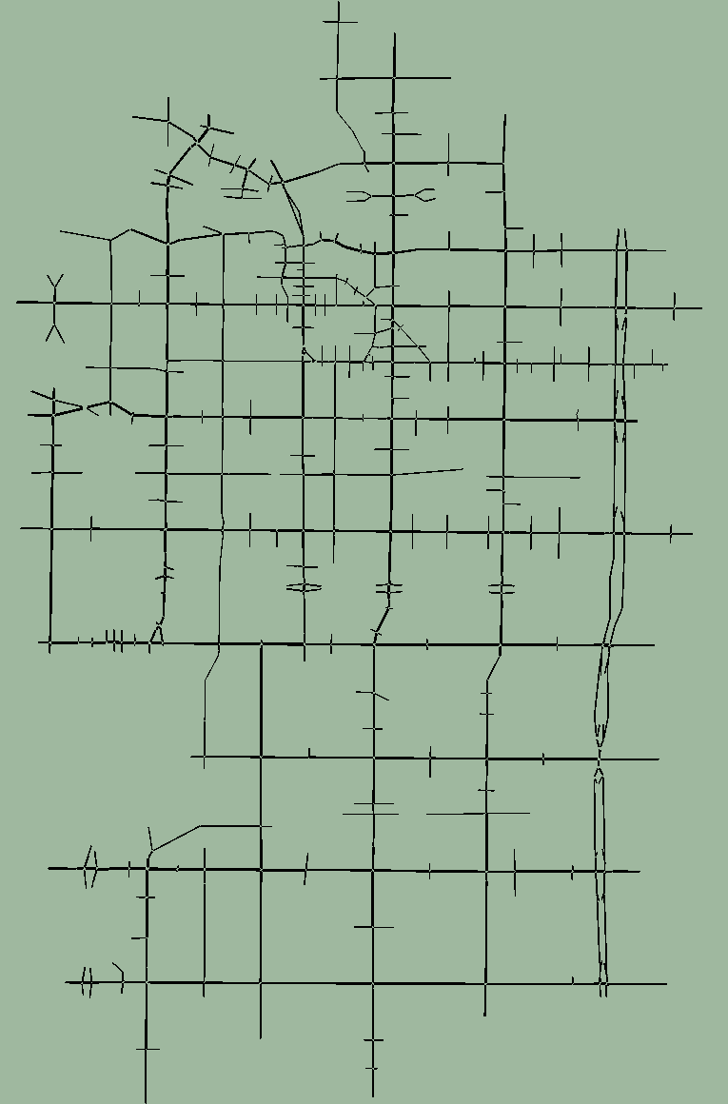
Synchro UTDF Network - GMNS Network - SUMO Network
(755 intersections, including 227 signalized intersections)
Open in Synchro
Open in Kepler.gl, or QGIS, ArcMap …
Open in SUMO

Slide 4
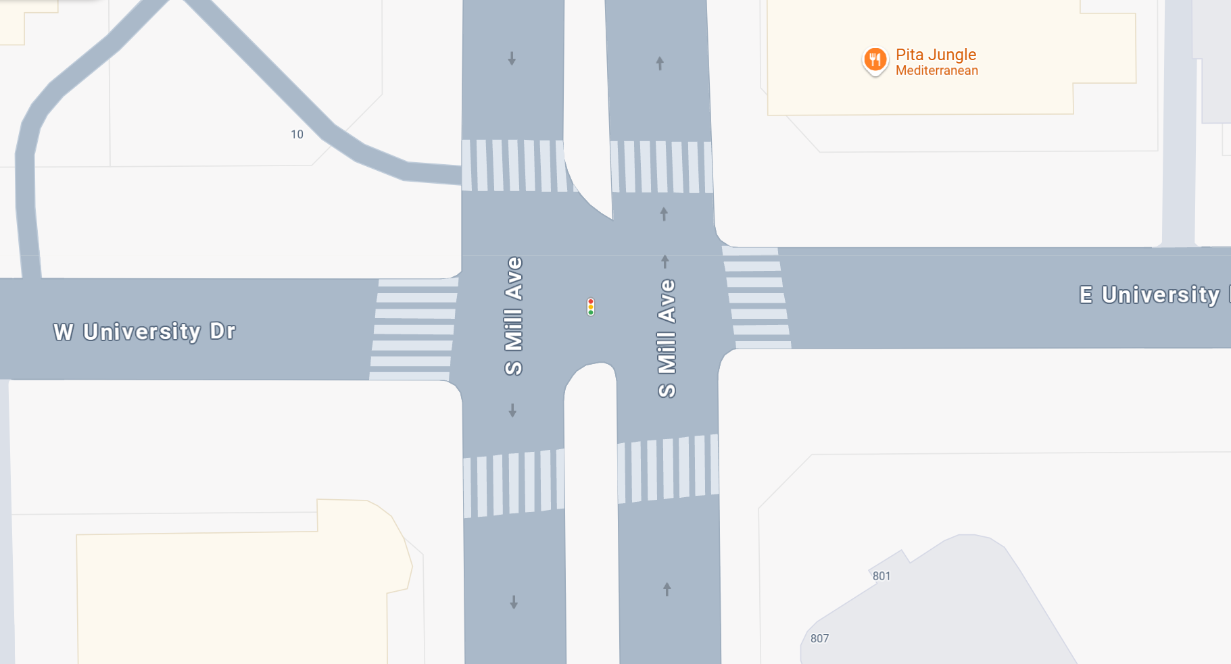
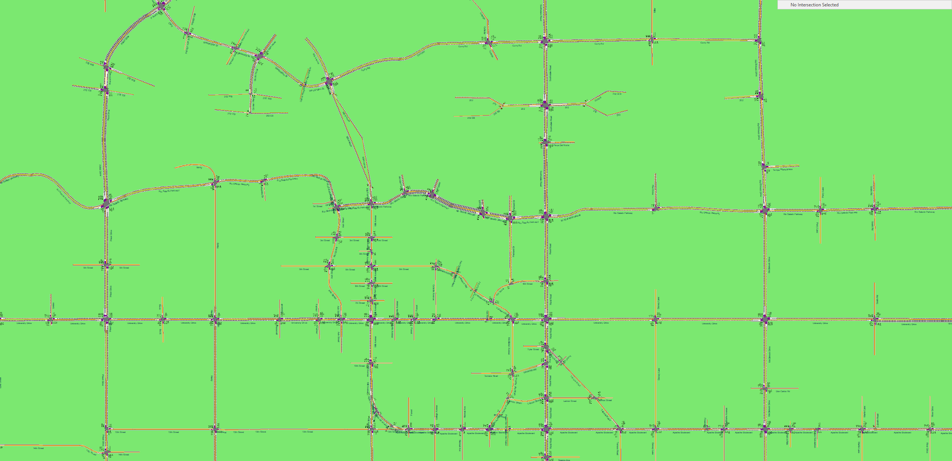
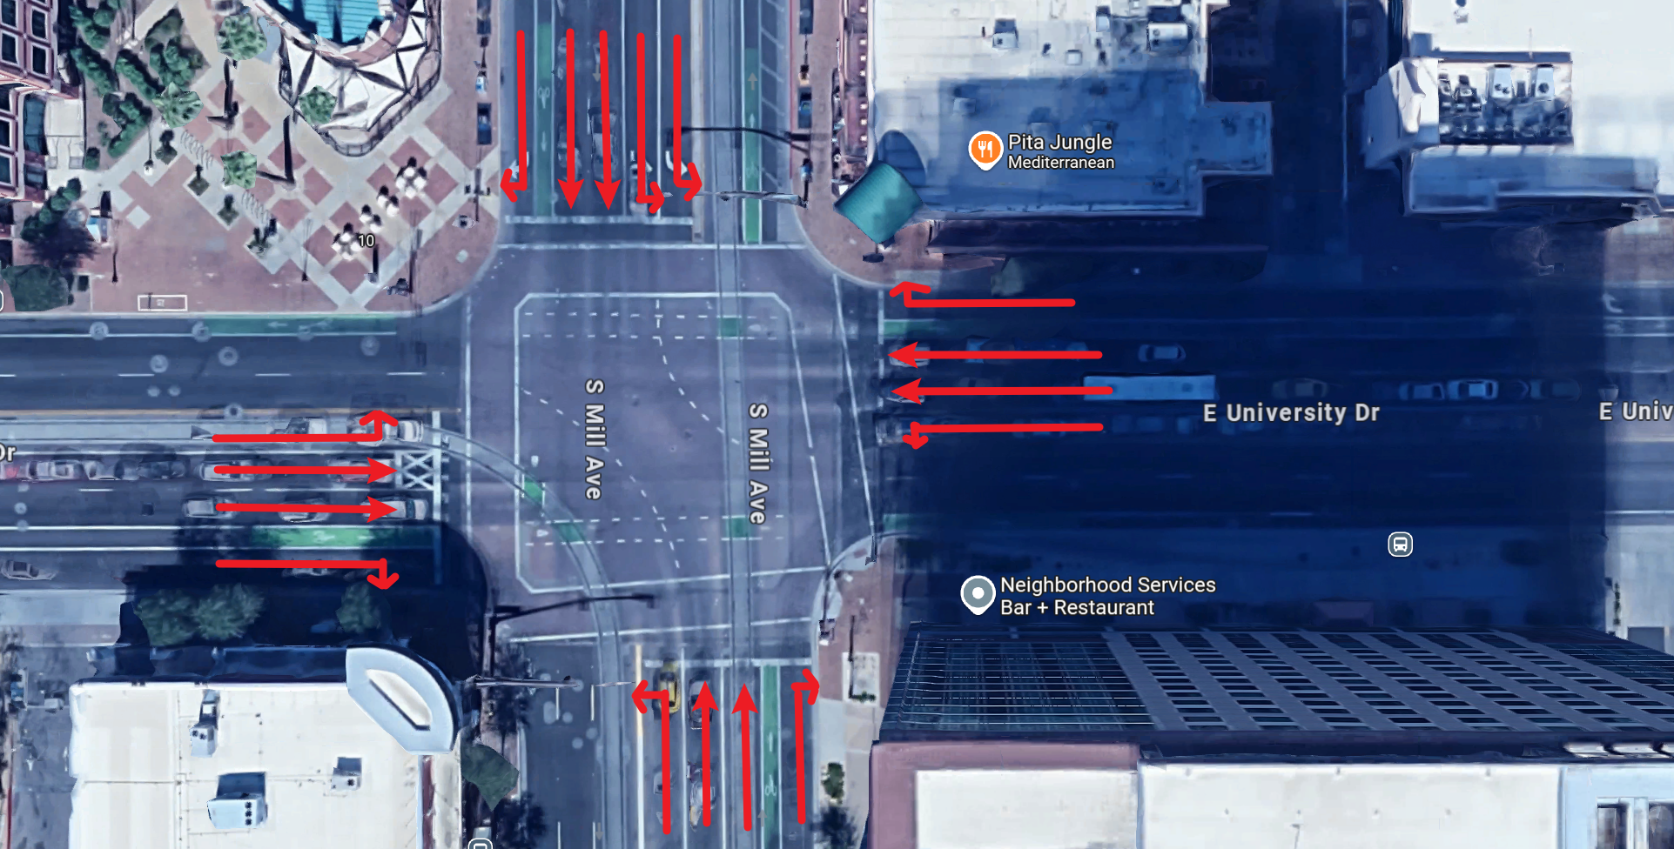
Synchro UTDF Network - Selection one intersection
Google Map Street View
Select One Intersection
Google Map 3D View

Slide 5
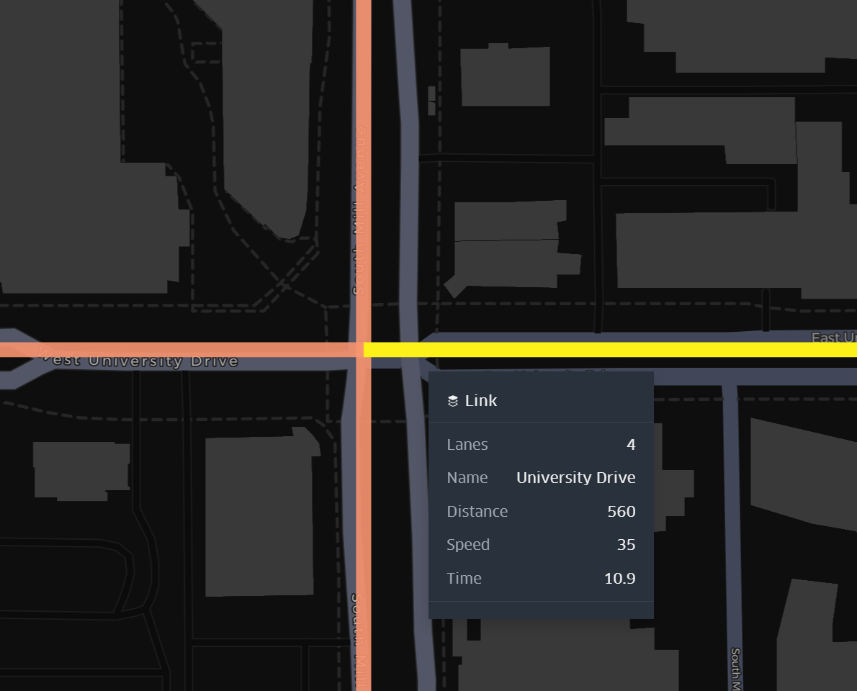
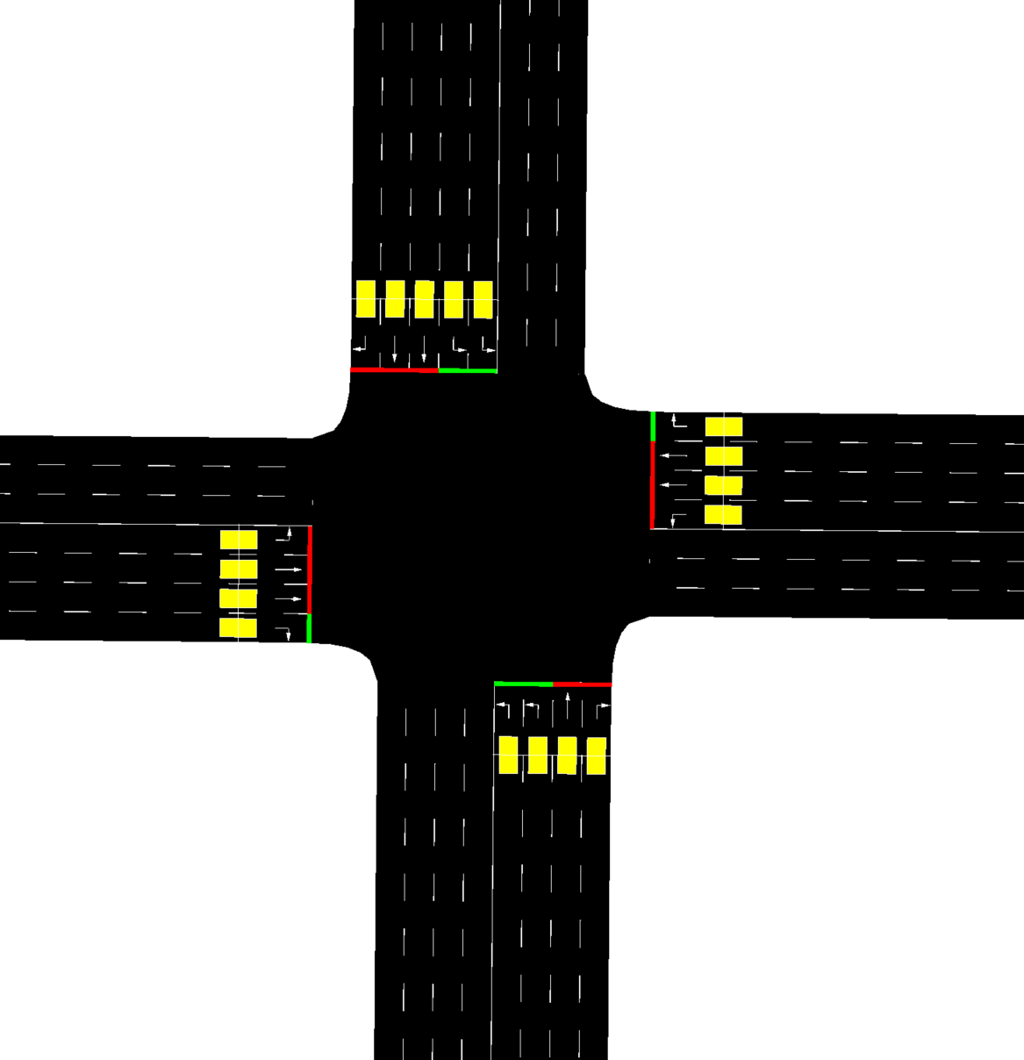
Synchro UTDF Network - Selection one intersection
GMNS View
SUMO View

Slide 6
UTDF-GMNS-SUMO Network

Slide 7
Intersection: University Dr & Mill Dr

Slide 8
Google Map Street View
Google Map 3D View

Slide 9
GMNS View
SUMO View

Slide 10
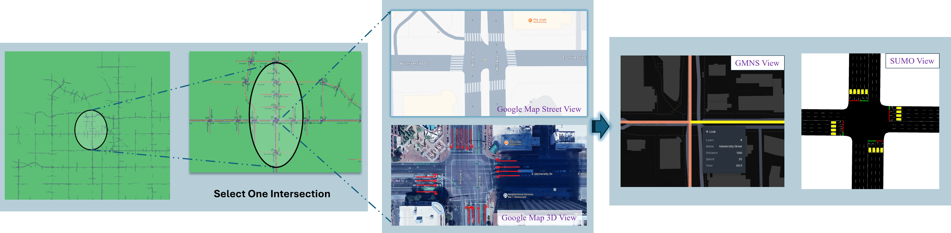
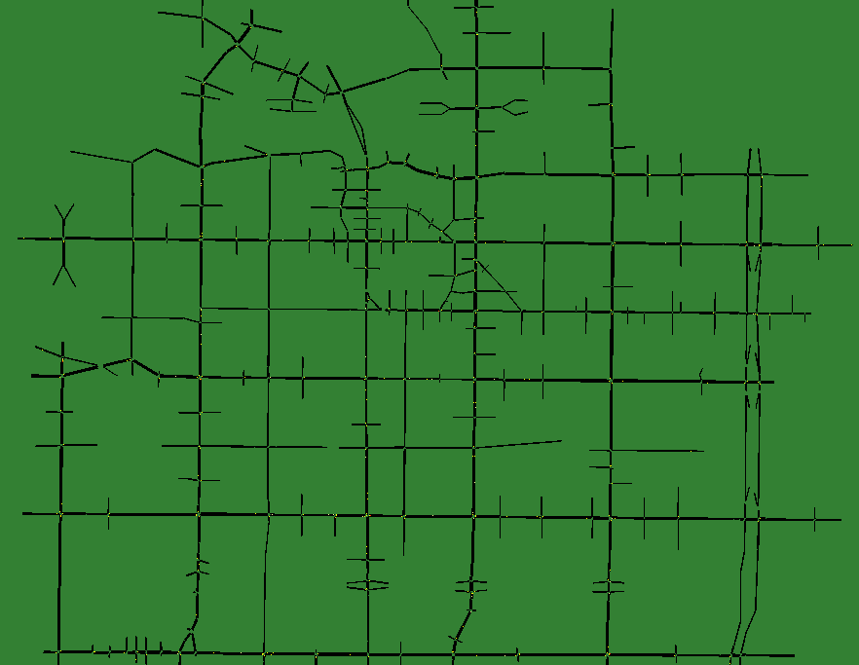
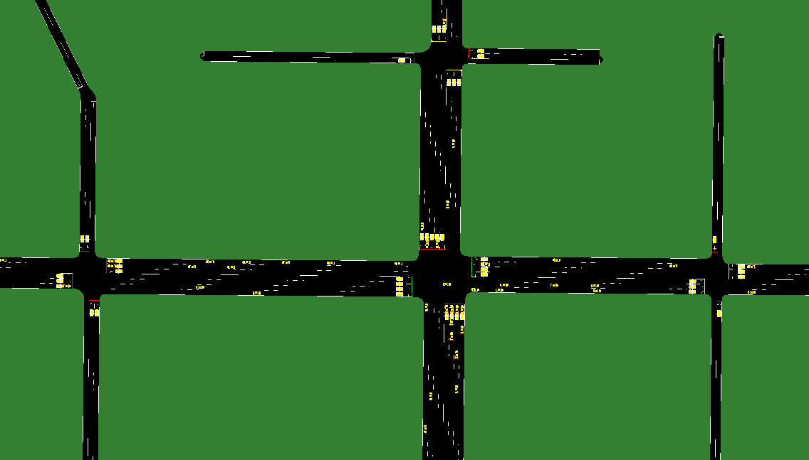
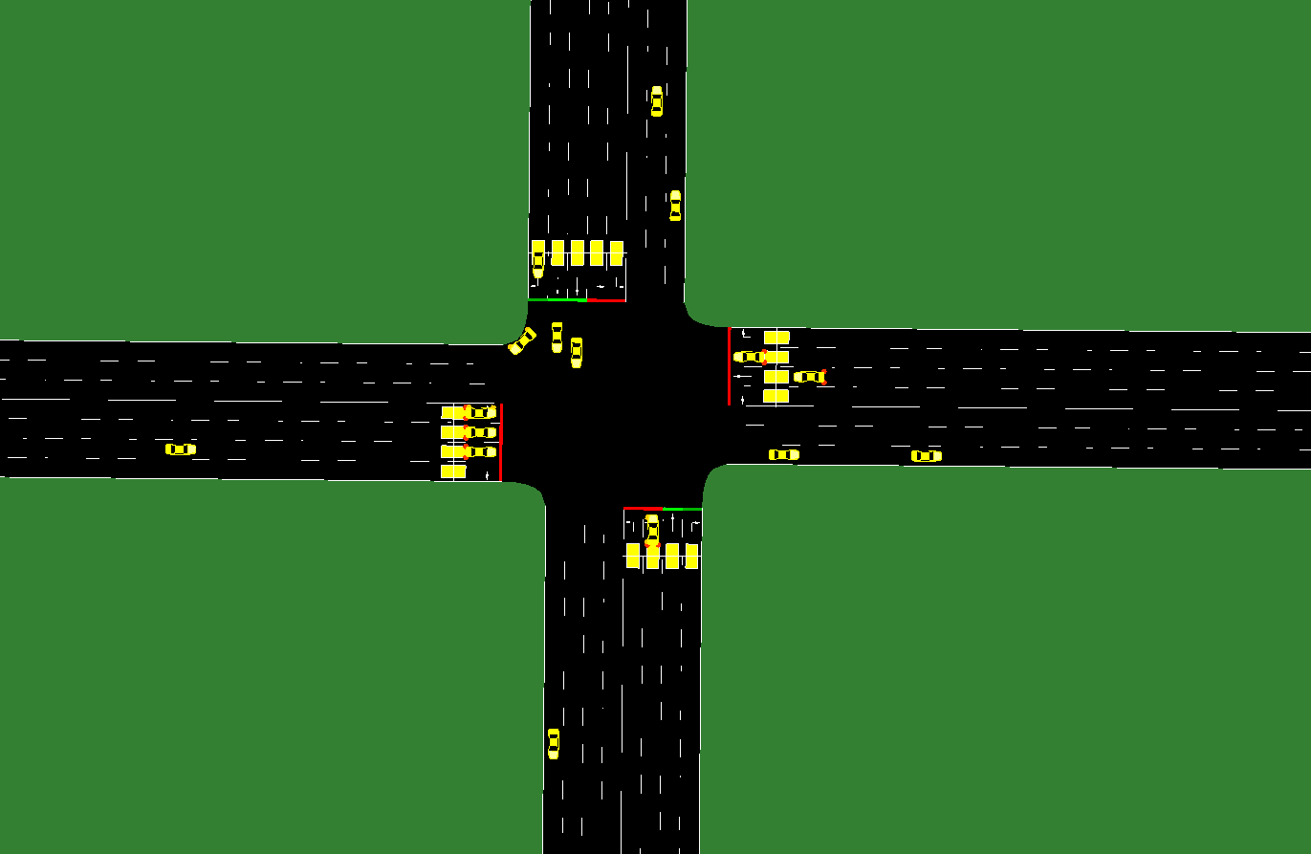
Simulation - Networks
Simulation - multiples
Simulation at one intersection

Slide 11
GMNS View
SUMO View
Google Map Street View
Select One Intersection
Google Map 3D View

